Slide 1

Game BaseD LEARNING
Name: Kohan Alexandru
Group: 831

Slide 2

Introduction
Help students collaborate, communicate, interact and work in teams.
Strategic games improve the functioning of brain.
Develop skills and build an emotional connection to learning and subject matter.

Slide 3
Overview and Definition
Game-based learning refers to the borrowing of certain gaming principles and applying them to real-life settings to engage users.
The motivational psychology involved in gamebased learning allows students to engage with educational materials in a playful and dynamic way.
Game-based learning is not just creating games for students to play, it is designing learning activities that can incrementally introduce concepts, and guide users towards an end goal.

Slide 4

Basis for Current Interest
Implemented workplace training, education, and social media.
Popular social media apps like Untappd and Foursquare engage their users in game based learning
These apps allow users to log their experiences, share with friends, and even earn badges for certain milestones like checking in the most times into a particular location.

Slide 5
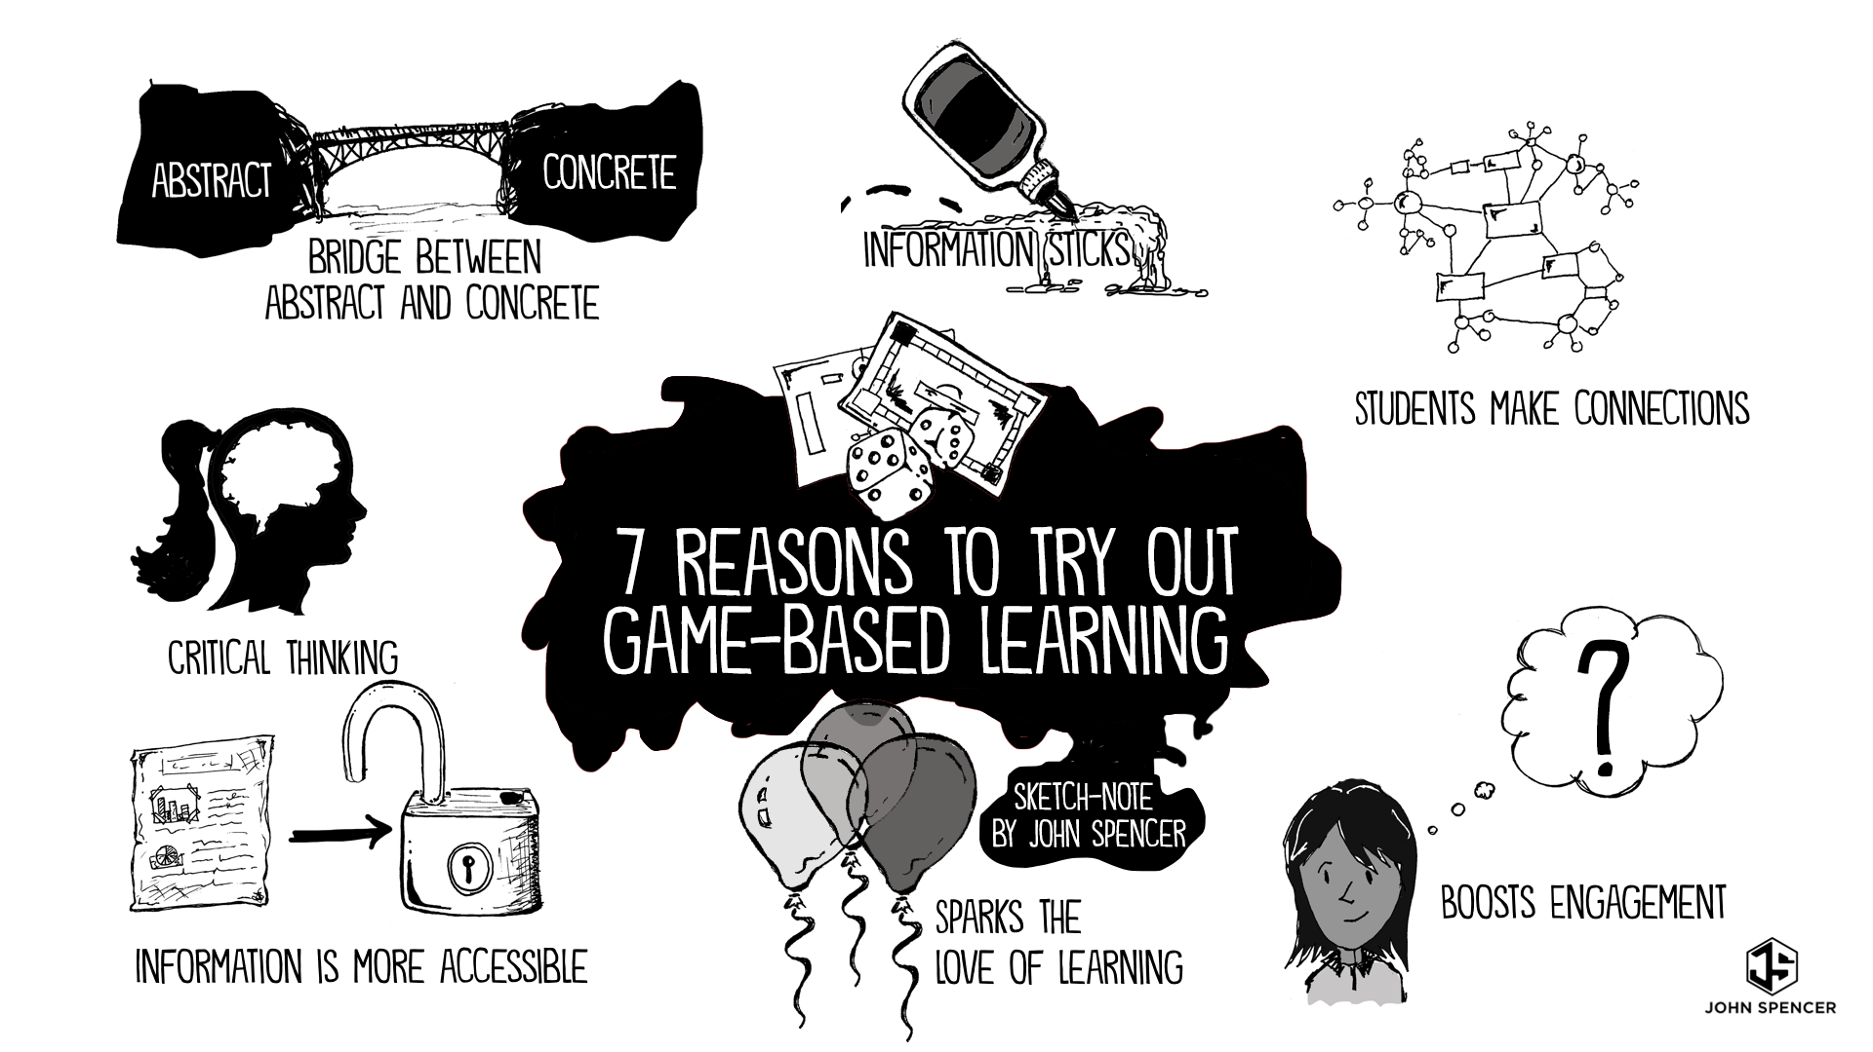

Slide 6
AGE CATEGORY
The 2014 NMC Horizon Report lists games and gamification as a trend in higher education.
The report states that “the average age of today’s gamers is 30, with 68% of gamers over 18 years old”.

Slide 7

Current Applications
University of Huddersfield Library uses a service called Lemontree.
Lemontree links students’ library accounts to award points for certain library activities such as checking out a book or looking up an article in a database.
Students collect points for doing these tasks, compete with each other, and keep track of their accomplishments via a leaderboard, which is displayed on the main homepage.

Slide 8
Potential Obstacles
Students’ proficiency with technology
Even for experienced game designers creating a game is difficult
Creating a game that effectively teaches and engages players
Game-development can require significant time and resources
Maintaining a project
Being supported as a long term project

Slide 9
Different types of GBL
01 – Board games
Monopoly can be considered an educational game. It has all the necessary elements: a story, characters, points, competition, and many other aspects.
02 – Real life games
The environment here is the real world. This is probably the most motivating, but also the most stressful type of game.
In this kind, students must move, act, use their body and their minds in order to play.
This is the most immersive type and it provokes students in almost every aspect of their learning.
03 – Digital games
The environment here is online.
Students have a character that moves through the game where they face challenges that are placed along the games’ path.
A digital game does not involve skills that are connected to the use of the body and the real space.

Slide 10

Conclusion
Game-based learning can be used in a variety of ways to enhance library instruction, and research across disciplines supports its effectiveness in the classroom.
When designed with learning principles in mind, games can increase student motivation, engagement, and learning.

Slide 11
Bibliography
spring2015.pdf (ala.org)
The Importance of Game Based Learning in Modern Education
Game-Based Learning > What Is, GBL vs Gamification, Types, Benefits
Game-Based Learning (carleton.edu)
Game Based Learning: Definition and Examples | Study.com

